Slide 1
Categorical Variables and one-hot encoding
Dr. Umberto Michelucci
umberto.michelucci@toelt.ai

Slide 2
Categorical Variables Types I
Nominal Categorical Variables:
Gender: Categories like male, female, non-binary.
Marital Status: Categories such as single, married, divorced, widowed.
Blood Type: Groups like A, B, AB, O.
Nationality: American, British, Canadian, etc.
Car Make: Ford, Toyota, Honda, etc.
Colors: Red, blue, green, yellow.
Types of Pets: Dog, cat, bird, fish.

Slide 3
Categorical Variables Types II
Ordinal Categorical Variables:
Education Level: High school, bachelor's degree, master's degree, doctorate.
Socioeconomic Status: Low, middle, high.
Hotel Ratings: 1-star, 2-star, 3-star, 4-star, 5-star.
Customer Satisfaction: Very unsatisfied, unsatisfied, neutral, satisfied, very satisfied.
Size: Small, medium, large, extra-large.
Military Ranks: Private, Corporal, Sergeant, Lieutenant, Captain.
Stages of a Disease: Early stage, middle stage, advanced stage.

Slide 4
One-hot encoding
One-hot encoding is a technique used to convert categorical variables into a form that could be provided to machine learning algorithms to do a better job in prediction. It involves representing each categorical variable with a binary vector that has one binary value for each category of the variable.

Slide 5
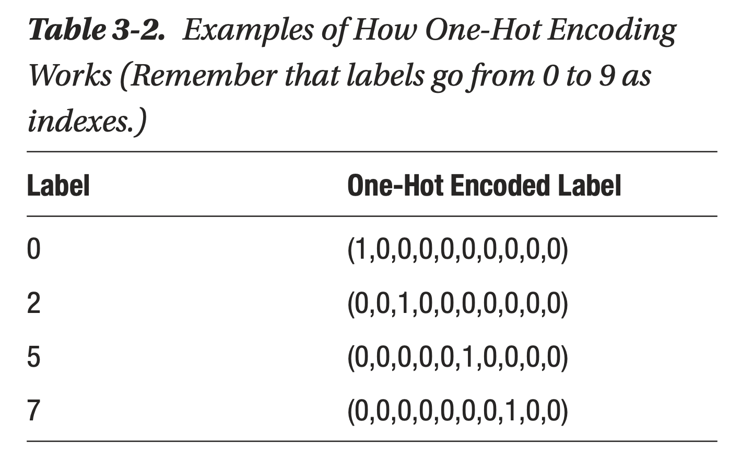
One-hot encoding – 10 labels (0,1,…,9)
Michelucci, Umberto. "Applied deep learning." A Case-Based Approach to Understanding Deep Neural Networks (2018).

Slide 6
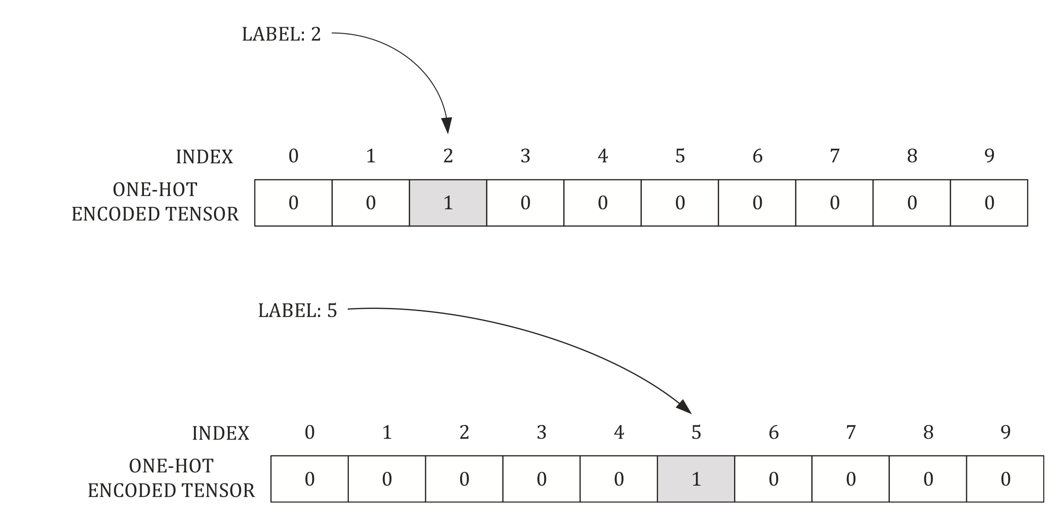
One-hot encoding – 10 labels (0,1,…,9)
Michelucci, Umberto. "Applied deep learning." A Case-Based Approach to Understanding Deep Neural Networks (2018).

Slide 7
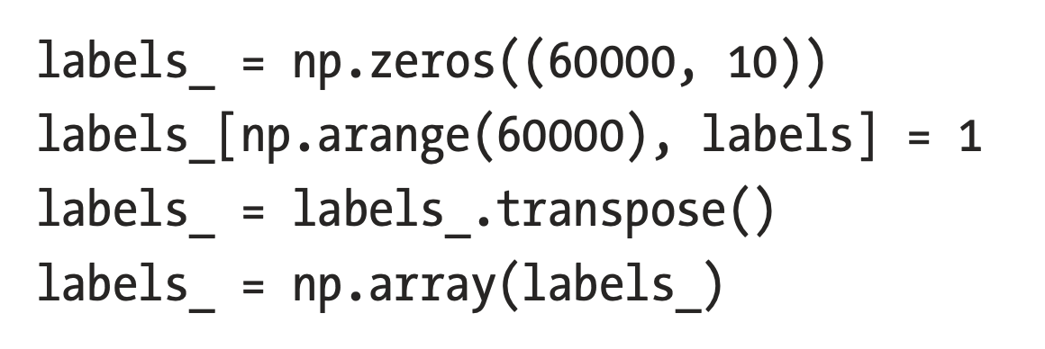
One-hot encoding – 10 labels (0,1,…,9)
How to do it in Python manually
Michelucci, Umberto. "Applied deep learning." A Case-Based Approach to Understanding Deep Neural Networks (2018).

Slide 8
One-hot encoding – 10 labels (0,1,…,9)
How to do it in Python with scikit-learn
encoder = OneHotEncoder(sparse=False)
y_one_hot = encoder.fit_transform(y.reshape(-1, 1))
Michelucci, Umberto. "Applied deep learning." A Case-Based Approach to Understanding Deep Neural Networks (2018).

